Slide 1

Network Layer:
Subnetting
Lecture 8 | CSE421 – Computer Networks
Department of Computer Science and Engineering
School of Data & Science

Slide 2
Objectives
IPv4 Exhaustion
Solution to the depletion of IPv4
Types of Subnetting
Examples

Slide 3
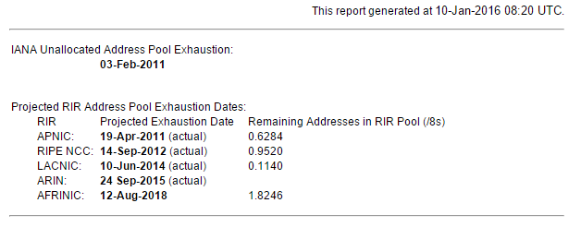
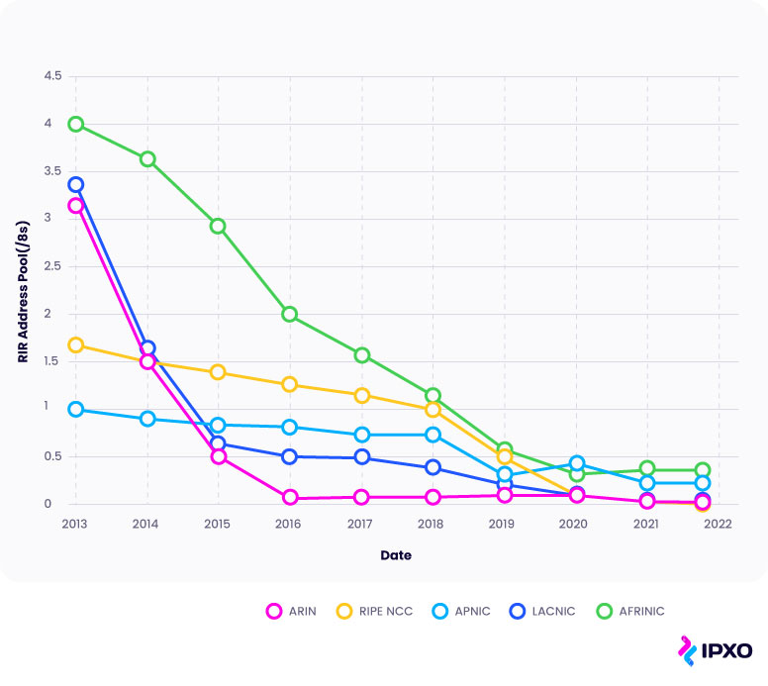

IPv4 Address Exhaustion

Slide 4
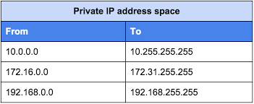
Solutions
Long term:
  Change to IP version 6.
  Plenty of addresses using a different scheme
Short term:
  Use Subnetting to avoid wasting addresses
  Use private addresses locally and NAT for internet access – lets many host share a few public addresses

Slide 5
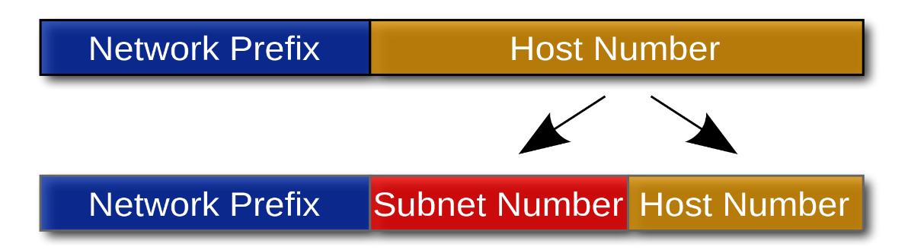
Subnetting
Partition a single physical network into more than one smaller logical sub-networks (subnets).
Borrow bits from the IP address's host part
Use these bits to create a number of smaller sub-networks inside the original network.
Notes:
Subnets are designed by accepting bits from the IP address's host part and using these bits to assign a number of smaller sub-networks inside the original network.
Allows an organization to add sub-networks without the need to acquire a new network number via the Internet service provider (ISP).

Slide 6
Subnetting
Two methods of subnetting
  Fixed Length Subnet Masking
  Variable Length Masking

Slide 7
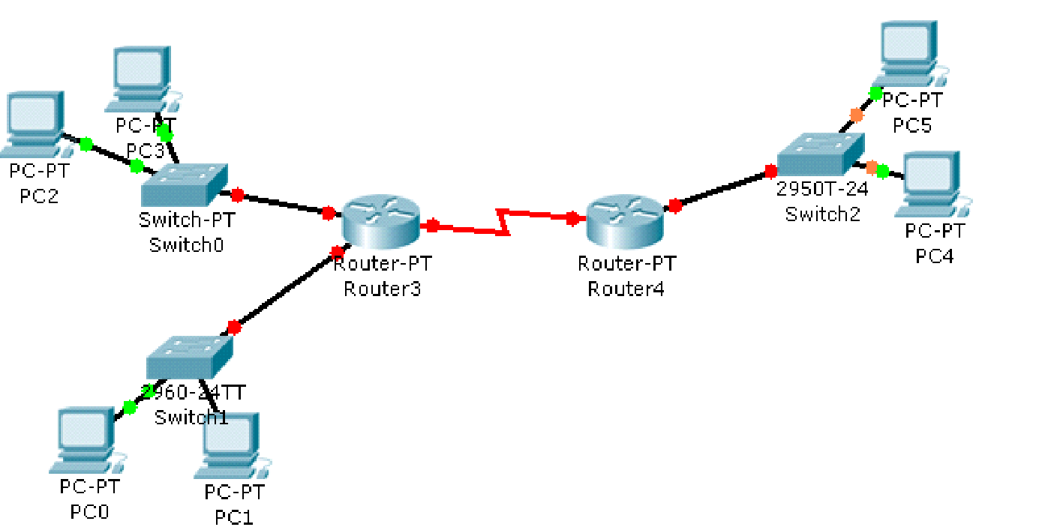
Fixed length subnetting
  How many network addresses do you need for the organization?
  How many network addresses do you have?
  How many bits do you have for hosts?
  How many host bits do you need to borrow to create the number of sub networks that you need?
200.20.20.0/24
8 bits
2 bits
1
3
Banani Branch
10 Hosts
4
2
Khulna Branch
60 Hosts
Motijheel Branch
40 Hosts

Slide 8
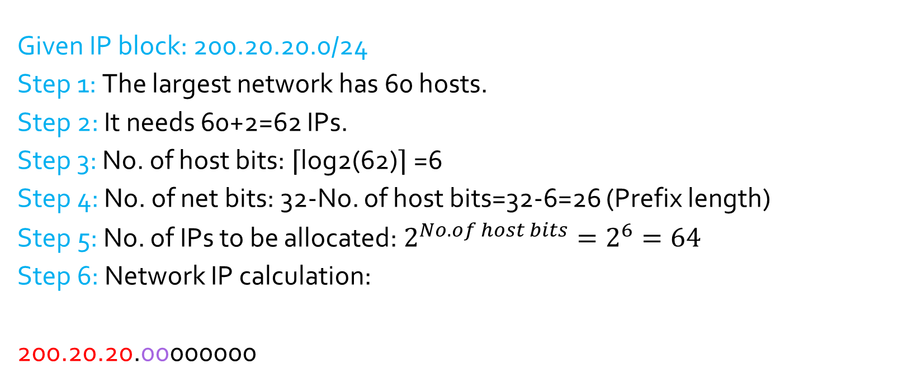

Host bits
200.20.20.00000000 =200.20.20.0 Network ID of 1
200.20.20.01000000 =200.20.20.64 Network ID of 2
200.20.20.10000000 =200.20.20.128 Network ID of 3
200.20.20.11000000 =200.20.20.192 Network ID of 4
Net bits
Subnet Host bits
Subnet ID bits

Slide 9
A company has been allocated the IP block 2.128.0.0/10 for its internal network.
Allocate addresses to five departments with different host requirements.
Network A: 40,000 hosts
Network B: 35 hosts
Network C: 2 hosts
Network D: 1,00,000 hosts
Network E: 1,000 hosts
Find the network IP addresses of each network.

Slide 10
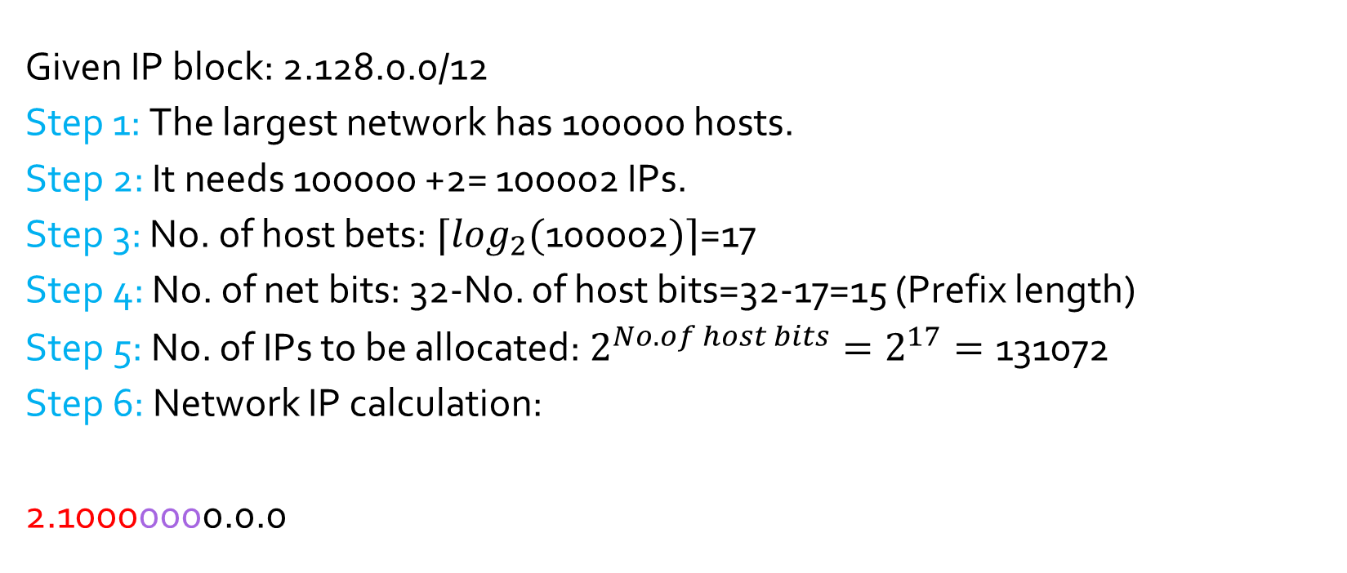
2.10000000.0.0 =2.128.0.0 Network ID of 1
2.10000010.0.0 = 2.130.0.0 Network ID of 2
2.10000100.0.0 = 2.132.0.0 Network ID of 3
2.10000110.0.0 = 2.134.0.0 Network ID of 4
2.10001000.0.0 = 2.136.0.0 Network ID of 5
Host bits
Net bits
Subnet ID bits
Subnet Host bits

Slide 11
Lots of Waste!
Problem of Fixed Subnetting:
  Waste IPv4 addresses.
  For example : Router3 –Router2 Network requires 2 IP addresses.
  How many is available? How many wasted?
62
60
200.20.20.192/26
  If you are using private addresses, then you may not be bothered.
  Waste of public addresses does matter.
Solutions:
  Variable Length Subnet Masking (VLSM)
    Create subnets as per specific host requirements.

Slide 12
VLSM
Also known as “Variable Length Subnet Masking”
  Assign a block of IP satisfying only that particular LAN.
    200 hosts? Assign a block of size 256 IPs!
    1000 hosts? Assign a block of size 1024 IPs!
    2 Hosts? Assign a block of size 2 IPs!
Always satisfy the requirements of your biggest LAN and then work your way down to the smallest LAN.

Slide 13
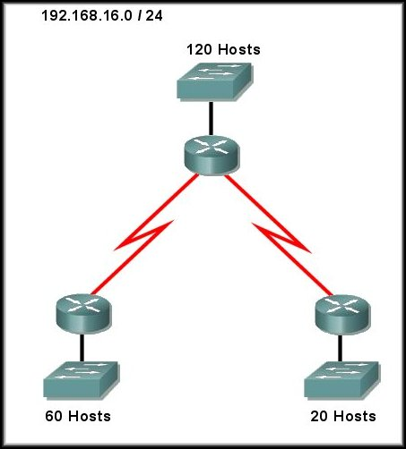
VLSM Example 1

Slide 14
IP Block: 192.168.16.0/24
11000000.10101000.00010000.00000000
Net128: 11000000.10101000.00010000.00000000
Net64: 11000000.10101000.00010000.00000000
Net32: 11000000.10101000.00010000.00000000
Net2: 11000000.10101000.00010000.00000000
Hosts, H | H2=Host+2, | No. of host bits: Hb= 2^{Hb} | No. of net bits, Nb=32-Hb (prefix length) | No. of Allocated IPs | Network IP | SM | For next subnet
120 | 122 | 7 | 25 | 128 | 192.168.16.0 | 255.255.255.128 | 256-128=128
60 | 62 | 6 | 26 | 64 | 192.168.16.0+128=192.168.16.128 | 255.255.255.192 | 256-192=64
20 | 22 | 5 | 27 | 32 | 192.168.16.128+64=192.168.16.192 | 255.255.255.224 | 256-224=32
2 | 4 | 2 | 30 | 4 | 192.168.16.192+32=192.168.16.224 | 255.255.255.252 | 256-252=4
2 | 4 | 2 | 30 | 4 | 192.168.16.224+4=192.168.16.228 | 255.255.255.252

Slide 15
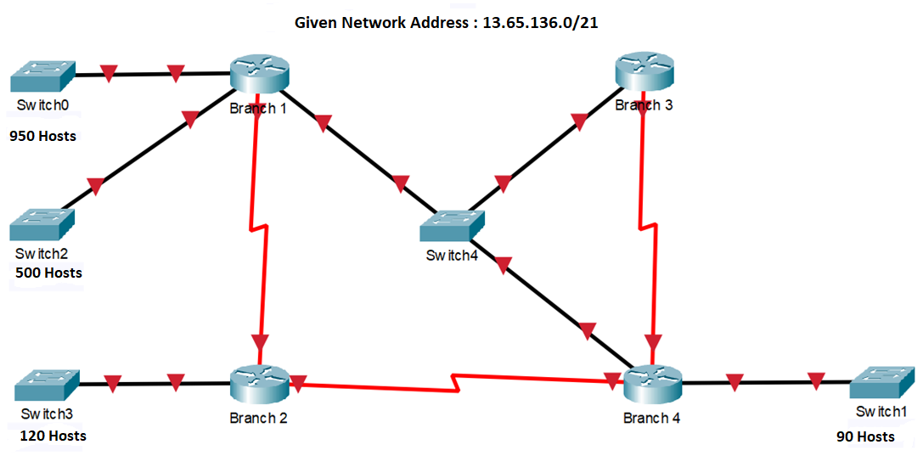
VLSM Example 2
4 LANs
3 WANs
1 Switched Network
Or Multi Access Networks

Slide 16
IP Block: 13.65.136.0/21
00001101.01000001.10001000.00000000
Net1024: 00001101.01000001.10001000.00000000
Net512: 00001101.01000001.10001000.00000000
Net128: 00001101.01000001.10001000.00000000
Net8: 00001101.01000001.10001000.00000000
Net4: 00001101.01000001.10001000.00000000
Hosts, H | H2=Host+2, | No. of host bits: Hb | No. of net bits, Nb=32-Hb (prefix length) |  | Network IP | SM | For next subnet
950 | 952 | 10 | 22 | 1024 | 13.65.136.0 | 255.255.252.0 | 256-252=4
500 | 502 | 9 | 23 | 512 | 13.65.136+4.0 =13.65.140.0 | 255.255.254.0 | 256-254=2
120 | 120 | 7 | 25 | 128 | 13.65.140+2.0 =13.65.142.0 | 255.255.255.128 | 256-128=128
90 | 92 | 7 | 25 | 128 | 13.65.142.0+128 =13.65.142.128 | 255.255.255.128 | 256-128=128
3 | 5 | 3 | 29 | 8 | 13.65.142.128+128=13.65.143.0 | 255.255.255.248 | 256-248=8
2 | 4 | 2 | 30 | 4 | 13.65.143.0+8=13.65.143.8 | 255.255.255.252 | 256-252=4
2 | 4 | 2 | 30 | 4 | 13.65.143.8+4=13.65.143.12 | 255.255.255.252 | 256-252=4
2 | 4 | 2 | 30 | 4 | 13.65.143.12+4=13.65.143.16

Slide 17
Teach Yourself
A company has been allocated the IP block 2.128.0.0/10 for its internal network.
Allocate addresses to five departments with different host requirements.
Network A: 40,000 hosts
Network B: 35 hosts
Network C: 2 hosts
Network D: 1,00,000 hosts
Network E: 1,000 hosts
Find the network IP addresses of each network in the most efficient way.

Slide 18
2.128.0.0/10
00000010.10000000.00000000.00000000
Net131072: 00000010.10000000.00000000.00000000
Net65536: 00000010.10000000.00000000.00000000
Net1024: 00000010.10000000.00000000.00000000
Net64: 00000010.10000000.00000000.00000000
Net4: 00000010.10000000.00000000.00000000
Hosts, H | H2=Host+2, | No. of host bits: Hb | No. of net bits, Nb=32-Hb (prefix length) |  | Network IP | SM | For next subnet
100000 | 100002 | 17 | 15 | 131072 | 2.128.0.0 | 255.254.0.0 | 256-254=2
40000 | 40002 | 16 | 16 | 65536 | 2.128+2.0.0=2.130.0.0 | 255.255.0.0 | 256-255=1
1000 | 1002 | 10 | 22 | 1024 | 2.130+1.0.0=2.131.0.0 | 255.255.252.0 | 256-252=4
35 | 37 | 6 | 26 | 64 | 2.131.0+4.0=2.131.4.0 | 255.255.255.192 | 256-192=64
2 | 4 | 2 | 30 | 4 | 2.131.4.0+64=2.131.4.64 | 255.255.255.252

Slide 19
The End

